Slide 1
Language Modeling
Suggesting words to a player to form a plausible sentence

Slide 2
why
“
You should be able to construct something that looks like an English sentence, similar to randomly tapping auto suggested words when composing a text.
Generate the first batch of words and wait for the user to select a word from among these in the terminal
Suggest further words based on the first choice
Keep suggesting words until word limit is reached, then print out the sentence and terminate
”
First milestone from Gameplay Summary

Slide 3

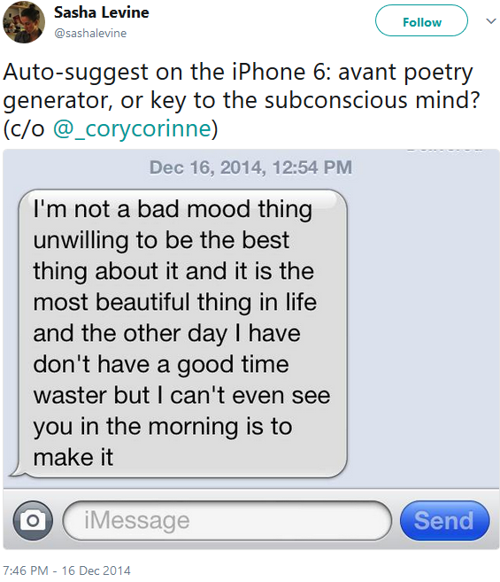
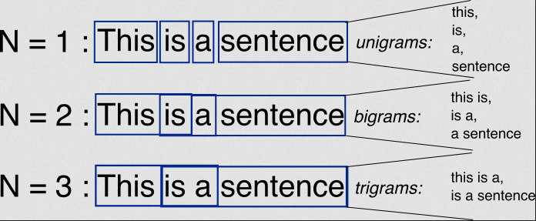
N-grams in action
an n-gram is a contiguous sequence of n items from a given sample of text or speech. The items can be phonemes, syllables, letters, words or base pairs according to the application. The n-grams typically are collected from a text or speech corpus.
https://stackoverflow.com/questions/18193253/what-exactly-is-an-n-gram

Slide 4
Using a 2-gram to predict the next word
“Let’s meet at Times …”
P(“Square”) > P(“banana”)
The probability of the next word being “Square” is likely higher than the probability of the next word being “banana”
This depends on the “corpus” or training set
“Times Square” has to occur more commonly than “Times banana” in whatever body of text we used to train the algorithm.

Slide 5
1-gram, 2-gram, red-gram, blue-gram
A N = 1 n-gram doesn’t take into account any of the preceding words, so what comes out doesn’t look like a sentence
N = 2 kinda looks like a sentence
N = 3 looks a lot like a sentence
N > 3 is generally the practical limit. There aren’t a lot of groups of 4 or more words that recur in training data.

Slide 6
Example
Write the array of all N-grams contained in a given sentence for the given value of N.
N = 2
“You came to the wrong hood, blanco niño!”
[
[“You, “came”],
[“came, to”],
[“to, the”],
[“the, wrong”],
[“wrong, “hood”],
[“hood, blanco”],
[“blanco, niño”]
]

Slide 7
Example
Write the array of all N-grams contained in a given sentence for the given value of N.
N = 3
“Y can’t we b friends tho?”
[
[“Y”, “can’t”, “we”],
[“can’t”, “we”, “b”],
[“we”, “b”, “friends”],
[“b”, “friends”, “tho”],
]

Slide 8
Technical detail
In the implementation, you would probably have some kind of control sequence indicating the start of a sentence, e.g. a NULL value or empty string.
[
[“Y”, “can’t”, “we”],
[“can’t”, “we”, “b”],
[“we”, “b”, “friends”],
[“b”, “friends”, “tho”],
]
[
[NULL, NULL, “Y”],
[NULL, “Y”, “can’t”],
[“Y”, “can’t”, “we”],
[“can’t”, “we”, “b”],
[“we”, “b”, “friends”],
[“b”, “friends”, “tho”],
]

Slide 9
How do we pick a training set?
As mentioned, the probability of a particular sequence of words depends on the training set. If we want:
Wholesome 80’s Hip Hop, G-Funk, Screw, 90’s Conscious Rap, etc…
then the bottom line is we need to get a big set of existing lyrics for each one.

Slide 10
Homework
Read parts 1-3 (LOOOONG) of this how-to guide
http://dataffiti.com/2016/01/17/analyzing-rap-lyrics-part-1-of-3-creating-a-corpus/
http://dataffiti.com/2016/03/09/analyzing-rap-lyrics-part-2-preparing-cleaning-and-exploring-rap-lyrics/
http://dataffiti.com/2016/06/20/long-time-between-posts/

